Slide 1


MOTHER THERESA INSTITUTE OF COMPUTER APPLICATIONS (Affiliated to S. V. University, Tirupati) SRI VENKATESHWARA UNIVERSITY-TIRUPATI A MAJOR PROJECT Advanced Online Learning Platform for Personalized Education and Enhanced Student Engagement
BY K . ROHIT KUMAR Reg: 2723188 UNDER THE VALUABLE GUIDANCE
OF
MR.K. CHANDRA SEKHAR,MSC,M.PHIL(PHD) ASSOCIATE PROFESSOR-MCA

Slide 2
Advanced Online Learning Platform for Personalized Education and Enhanced Student Engagement
2723188 - Kudumu Rohit Kumar

Slide 3
Abstract
This project is an Online Learning Platform made with Django that helps users learn in a simple and fun way. Users can sign up, get their own account, and log in to view and buy courses. They can watch course videos, check their payment history, and get instant help from a chatbot. Users can also send feedback, and admins can reply, manage courses, and assign work. The platform uses AI to give smart learning support and make the experience better for everyone.

Slide 4
Introduction
This Online Learning Platform is built to help people learn from anywhere at any time. It allows users to create an account, explore different courses, and learn through videos. The system is easy to use and makes learning more interesting with helpful tools like a chatbot. Users can also give feedback and get replies from the admin. The main goal is to make learning simple, smart, and fun for everyone.

Slide 5
Existing System
Most learning platforms only offer basic video lessons without smart support.
Users can watch courses but don’t get personalized help or guidance.
Feedback options are limited, and responses from admins take time.
Course management is often manual and not flexible for updates.
There is no intelligent chatbot to answer users' questions quickly.

Slide 6
Limitations
No smart tutor to guide users based on their learning needs.
Users cannot get instant answers to their questions.
Admins have limited control over user feedback and course updates.
The system may not track user progress or learning history well.
Payment and course access may not be fully secure or user-friendly.

Slide 7
Proposed
Add smart tutoring with AI to give users helpful learning support.
Use a chatbot to answer user questions instantly.
Allow users to buy courses, watch videos, and track their payments easily.
Let admins manage users, courses, and feedback in a simple way.
Make the platform user-friendly, secure, and fun for both learners and admins.

Slide 8
Advantages
Easy to use for both learners and admins.
Smart chatbot gives quick answers to user questions.
Users can watch videos and track their learning easily.
Admins can manage courses, users, and feedback in one place.
AI helps provide better and more personalized learning support.

Slide 9
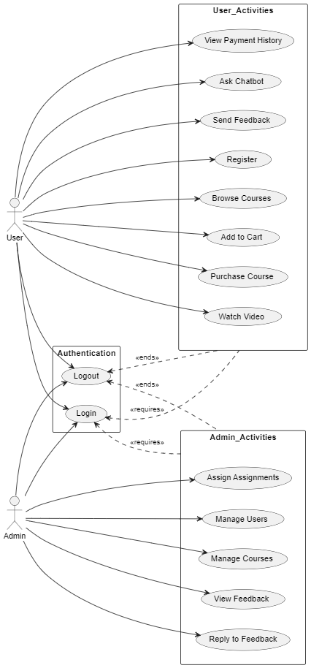
Use Case Digram

Slide 10
Use Case Digram
Users can register, login, and browse courses.
Users can purchase and watch video courses.
Admins can manage courses and users.
Feedback can be submitted by users and replied to by admins.
Chatbot helps users with instant queries.

Slide 11
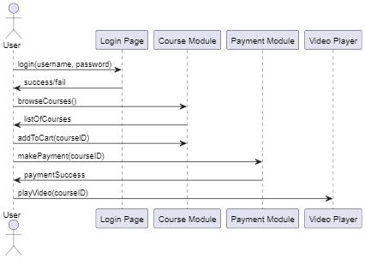
Sequence Digram

Slide 12
Sequence Digram
User logs in to the platform.
User views and selects a course.
User adds course to cart and makes payment.
System verifies payment and grants access.
User watches the course video.

Slide 13
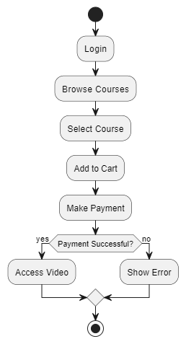
Activity Digram

Slide 14
Activity Digram
User logs into the platform.
User browses and selects a course.
Course is added to cart and payment is made.
If payment is successful, video is unlocked.
If payment fails, an error is shown.

Slide 15
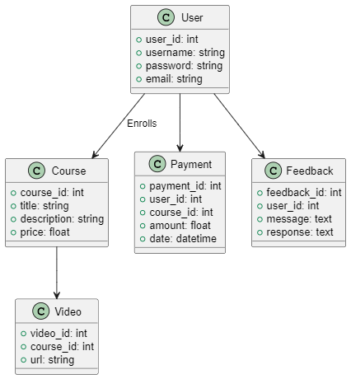
Class Digram

Slide 16
Class Digram
User, Course, Payment, Video, and Feedback are main classes.
Relationships exist between users and payments/feedback.
Each course has one or more videos.
Feedback contains optional admin response.
Classes define attributes relevant to each module.

Slide 17
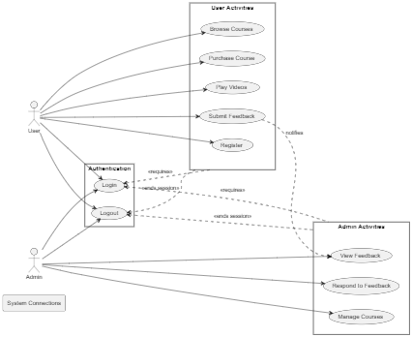
DFD Digram

Slide 18
DFD Digram
User interacts with login and course system.
Admin manages users, courses, and feedback.
Course browsing and purchases are processed.
Feedback is submitted and managed.
System flows are centralized in the learning platform.

Slide 19
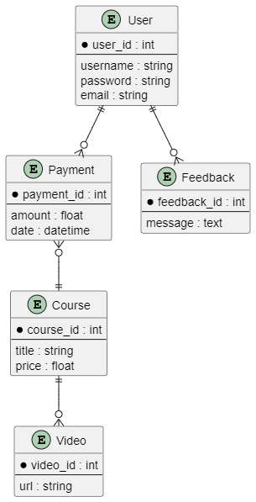
ER Digram

Slide 20
ER Digram
Users have unique IDs and credentials.
Courses have titles, prices, and descriptions.
Payments link users and purchased courses.
Videos belong to courses.
Feedback links users to messages and responses.

Slide 21
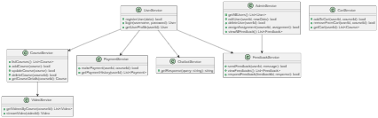
Class Method Digram

Slide 22
Class Method Digram
UserService handles login and registration.
CourseService manages all course operations.
PaymentService processes payments and shows history.
VideoService streams course content.
AdminService manages users, courses, and feedback.

Slide 23
Thank you

